Slide 1


TECH TUESDAY
SGP IS: School of Excellence
Getting Started with
Microsoft Bot Framework
Presented by Si Thu Win

Slide 2
Agenda
Basic feature of Bot Framework
Using Dialog and Form Flow
How to use Bot Emulator
Integration with Natural language Processing Framework (LUIS)
Deploy the bot to Azure and Facebook

Slide 3
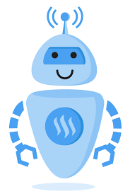
What is bot
Application that performs an automated task
Chat Bot
Cortana or Siri
Bots are the wave for the future
People want instant gratification
(chats, text, tweets)

Slide 4

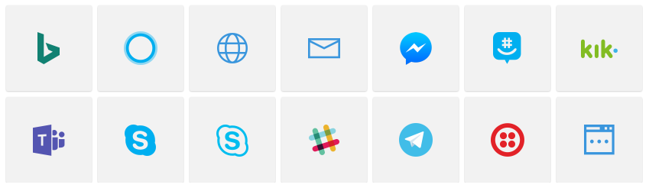
Bot Communication
Bot Channels
The medium in which your bot communicates

Slide 5
Microsoft Bot Framework
SDK For Building Bots
Introduced at Build 2016
Open Source
Node.js or .NET
Multiple Channels
Rich Attachment Support
Natural Language Processing

Slide 6
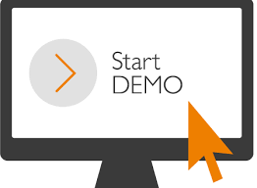
Bot
- Visual Studio 2017
- Bot Template
- Bot Emulator

Slide 7
Key Concepts in the Bot Builder SDK
Connector
REST API that enables a bot to communicate across multiple channels
Activity
Object to pass information back and forth between bot and channel (Message)
Dialog
Conversation Flow
Form Flow
Collects information from user
State
Store and retrieve state data

Slide 8
Bot Connector
The connector sits between your bot and the channels, and passes the messages between them
Facilitates communication between bot and user by relaying messages from bot to channel and from channel to bot
Bot Web Service
Connector Service
Channels

Slide 9
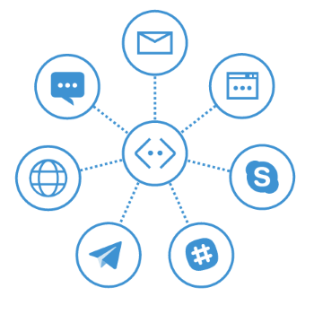
Connector Service and Activities
Channel
{Activity}
Connector Service
{Channel}

Slide 10
What are dialogs?
Breaks up conversations into smaller pieces
Portable and adhere to Single Responsibility Principle (SRP)
Hi, I’m NB Bot. What is your name?
Hi, I’m Jane.
Hi Jane, How can I help you today?

Slide 11
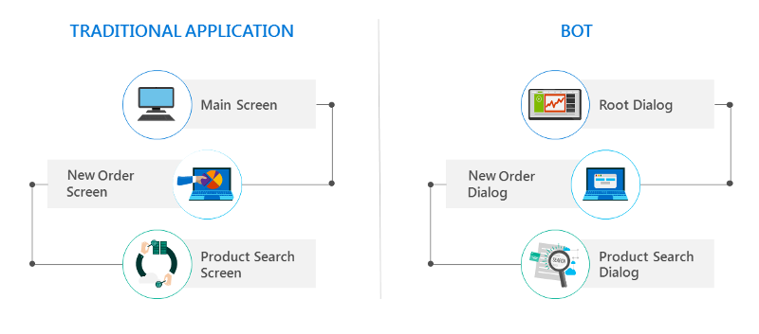
Dialog Chain
Introduction
Dialog
Context
Dialog
Farewell
Dialog

Slide 12
Dialog

Slide 13
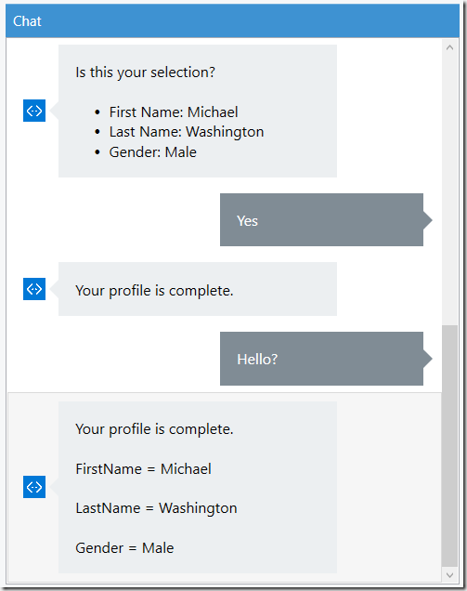
What is Form Flow?
More options with Less Effort
Features
Provides clear guidance and help
Understands both numbers and textual entries
Gives feedback on what is understood and not
Asks clarifying questions when needed
Allows navigation between steps
Messages during the process of filling in a form
Custom prompts per field
Templates to use when automatically generation prompts or help
Terms to match on
Whether to show choices and numbers or not
Fields that are optional
Conditional fields
Value validation

Slide 14
Form Flow (Booking a Hotel Room…)
How many rooms do you need?
1
How many guests?
2
When is your check in date?
09/21/2018

Slide 15
Form Flow

Slide 16
State
Saving User Data into
User Created SQL Database
Bot State Service

Slide 17
What is LUIS?
Language Understanding Intelligent Service
Designed to enhance your bot’s understanding of natural language through the technology of interactive machine learning.
Play the role of a translator for your bot

Slide 18
Without LUIS
Greeting Dialog
“Hi”
?
“Hello”

Slide 19
LUIS
Intents (Verb)
Identifies what actions you want your bot to take
Utilize Active Learning to improve over time
Entities (Noun)
Identifies what things your bot is taking action on
Helps to enhance your Intents
Can be Hierarchical or Composite
Utterances
Identifies phrases to link to intents and entities
Used to help LUIS learn
https://www.luis.ai/applications

Slide 20
LUIS
- Create Microsoft Account
- https://www.luis.ai/
- Create New App

Slide 21
Deploy to Azure
Create Account
Publish to Azure
Create Bot Service from https://dev.botframework.com/

Slide 23
Useful Link
Design:
https://docs.microsoft.com/en-us/azure/bot-service/bot-service-design-principles?view=azure-bot-service-3.0
Example:
https://github.com/Microsoft/BotBuilder-Samples/tree/master/CSharp

